Slide 1
Button Mash Master

Slide 2
Group Members
Jasper Phua
Tan Kin Lek
Ivan Leong
Muhammad Shafik bin Mazlinan

Slide 3
What is Button Mash Master?
Button Mash Master comprises of playing through a wide variety of competitive minigames.
It has simple game controls which comprises of the left, down and right buttons.
Each minigame explains its rules & controls before playing commences.

Slide 4
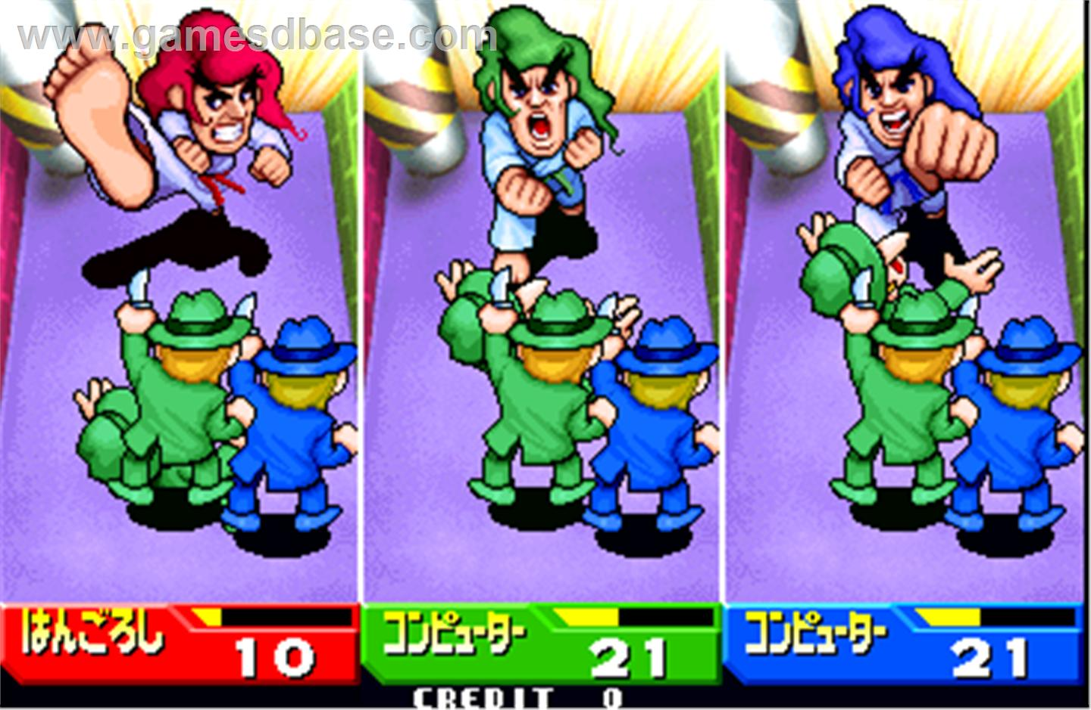
Inspirations for the game
Bishi-Bashi

Slide 5
Features
Normal mode/Random mode
Ranks for each minigame
High-Score System
ASCII sprite animations loaded from txt file
Unique Game Controls – Capture key triggered instead of key pressed.

Slide 6
Contributions
Jasper: 2 mini-games, credits & presentation.
Kin Lek: 2 mini-games, in-game menu, ranking system & trailer.
Ivan: 4 mini-games, the random game mode and the game document.
Shafik: Framework Edits(stopped flickering on the screen and support multiple file streams),created the game controls and 2 mini-games.

Slide 7
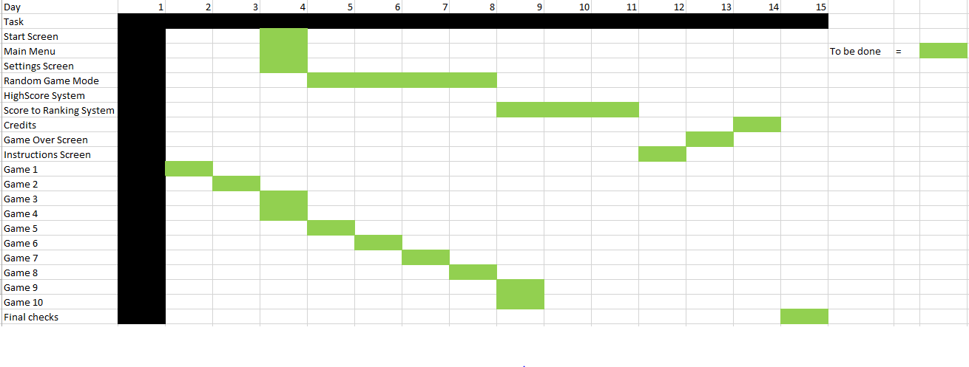
Gantt Chart

Slide 8
Problems and lessons
Problems
- framework was not suitable for our game.
- some of the games are too similar.
Lessons
- To have better planning before hand.
- To have better management of task

Slide 9
Any questions?

Slide 10
Thank you for listening!

